Slide 1
DataBase Introduction
Continuous staff improvement project
Yurii Hohan

Slide 2
Introduction
Database introduction.
What is ACID?
Table.
Data types.
PK and FK.
Operations to insert, update, delete data.
Constraints, defaults, not-nulls.
Using scripts to create Tables in Database.

Slide 3
What is database
A database is a set of data that has a regular structure and that is organized in such a way that a computer can easily find the desired information.
A database system is a computerized record-keeping system, whose overall purpose is to store information and allow concurrent users access to retrieve and update this information.

Slide 4
Acid
Atomicity requires that each transaction be "all or nothing": if one part of the transaction fails, the entire transaction fails, and the database state is left unchanged. An atomic system must guarantee atomicity in each and every situation, including power failures, errors, and crashes.
The consistency property ensures that any transaction will bring the database from one valid state to another.
The isolation property ensures that the concurrent execution of transactions results in a system state that would be obtained if transactions were executed serially, i.e., one after the other.
Durability means that once a transaction has been committed, it will remain so, even in the event of power loss, crashes, or errors.

Slide 5
Table. Relation.
A table is a collection of related data held in a structured format within a database. It consists of fields (columns), and rows.
In terms of the relational model of databases, a table can be considered a convenient representation of a relation, but the two are not strictly equivalent.
For instance, an SQL table can potentially contain duplicate rows, whereas a true relation cannot contain duplicate tuples.
A relation contains of set of attributes (columns) and tuples (row)

Slide 6
I/O. Pages. Extents.
When working with the database, we have to always remember of input/output.
The fundamental unit of data storage in SQL Server is the page.
The disk space allocated to a data file (.mdf or .ndf) in a database is logically divided into pages numbered contiguously from 0 to n.
Disk I/O operations are performed at the page level.
SQL Server reads or writes whole data pages.
Extents are a collection of eight physically contiguous pages and are used to efficiently manage the pages.

Slide 7
DataTypes
Exact numeric (INT, BIGINT)
Approximate numeric (FLOAT, REAL)
Character strings (CHAR, VARCHAR)
Binary strings (BINARY, VARBINARY)
Unicode strings (NCHAR, NVARCHAR)
Date and time (DATE, TIME, DATETIME2, SMALLDATETIME, DATETIME, DATETIMEOFFSET), and others.
Choosing the appropriate type for your data is to remember:
1. that a type is a constraint
2. the more restrictive the type, the more data will fit into the page
3. A data type encapsulates behavior. Don’t miss out on behaviour you need

Slide 8
DataTypes. CASTING
CAST, CONVERT, PARSE – try to convert and throw in case it is impossible
TRY_CAST, TRY_CONVERT, and TRY_PARSE – try to convert and return NULL if convertion is impossible.
CONVERT is SQL Server specific, CAST is ANSI.
PARSE is one of the new built-in conversion function introduced as a Part of Sql Server 2012. PARSE function converts the string expression to the requested data type. PARSE is little bit intelligent about string content.
For more info: http://sqlhints.com/tag/convert-vs-parse/
https://msdn.microsoft.com/ru-ru/library/ms187928.72efe197-3708-4fc3-8d58-4bfb0381dc1b(v=sql.130).jpeg?f=255&MSPPError=-2147217396

Slide 9
Primary Key
They show the field that identifies the record uniquely.
These are indicated by 'PK' alongside the field in a Table.
For example, the 'product_id' for a Product and an 'order_id' for an Order.
The values could be implemented using an 'Auto-Increment' field.
Knowing Product_Id, we can guarantee that we can deduce all its table info, like Product_Name, Product_Price, etc.

Slide 10
Foreign Key
They show a reference to the Primary Key for a record in another Table and are used for data consistency. E.g. - you cannot create an order for the product which does not exist at the time of its creation. This rule is called referential integrity constraint between the two tables
The foreign key is defined in a second table, but it refers to the primary key in the first table.
These are indicated by 'FK' alongside the field in a Table.

Slide 11
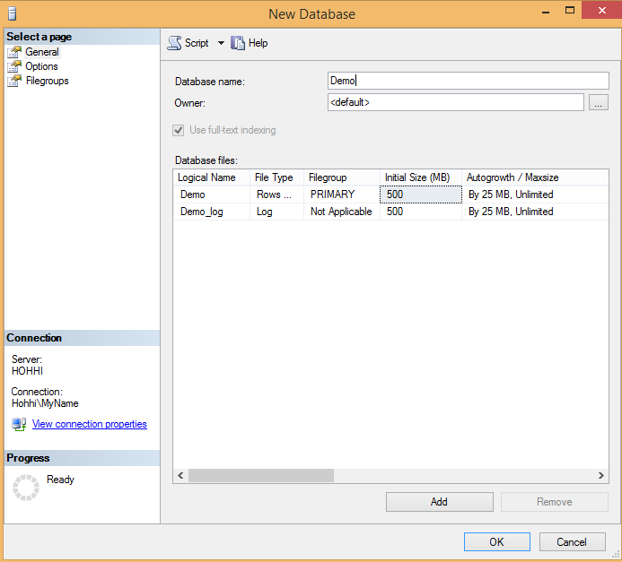
Create Database

Slide 12
Create Tables
CREATE TABLE [dbo].[Customers]
(
[Id] BIGINT NOT NULL,
[Name] NVARCHAR (50) NOT NULL,
[DefaultPostalCode] BIGINT NULL,
CONSTRAINT [PK_Customers] PRIMARY KEY CLUSTERED ([Id])
);

Slide 13
Create Tables
CREATE TABLE [dbo].[Orders]
(
[Id] BIGINT NOT NULL,
[Total] DECIMAL (18, 0) NOT NULL,
[PostalCode] BIGINT NOT NULL,
[CustomerId] BIGINT NOT NULL,
CONSTRAINT [PK_Orders] PRIMARY KEY CLUSTERED ([Id])
);
ALTER TABLE [dbo].[Orders] ADD CONSTRAINT [Orders_CustomerId] FOREIGN KEY ([CustomerId]) REFERENCES [dbo].[Customers] ([Id]) ON DELETE NO ACTION ON UPDATE NO ACTION;

Slide 14
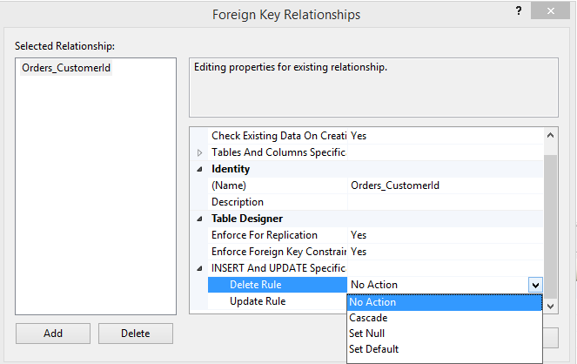
Foreign Key Cascades

Slide 15
Primary keys of type Identity
CREATE TABLE Persons
(
ID INT IDENTITY (1, 1) PRIMARY KEY,
LastName VARCHAR (255) NOT NULL,
FirstName VARCHAR (255) NOT NULL);
)
Now if we insert we can skip specifying the ID:
INSERT INTO Persons (FirstName, LastName)
VALUES ('Lars', 'Monsen');
But the autoincrement id will be generated.

Slide 16
SQL NOT NULL Constraint
The NOT NULL constraint enforces a column to NOT accept NULL values.
The NOT NULL constraint enforces a field to always contain a value. This means that you cannot insert a new record, or update a record without adding a value to this field.
CREATE TABLE PersonsNotNull
(
P_Id INT NOT NULL,
LastName VARCHAR (255) NOT NULL,
FirstName VARCHAR (255),
Address VARCHAR (255),
City VARCHAR (255)
);

Slide 17
SQL CHECK Constraint
The CHECK constraint is used to limit the value range that can be placed in a column.
If you define a CHECK constraint on a single column it allows only certain values for this column.
ALTER TABLE Persons
ADD CHECK (Salary > 0);
If you define a CHECK constraint on a table it can limit the values in certain columns based on values in other columns in the row.
ALTER TABLE Persons
ADD CONSTRAINT chk_Person CHECK (Salary > 0
AND Age > 18);

Slide 18
SQL DEFAULT Constraint
The DEFAULT constraint is used to insert a default value into a column.
The default value will be added to all new records, if no other value is specified.
CREATE TABLE Orders
(
O_Id INT NOT NULL,
OrderNo INT NOT NULL,
P_Id INT ,
OrderDate DATE DEFAULT GETDATE()
);

Slide 19
SQL UNIQUE Constraint
The UNIQUE constraint uniquely identifies each record in a database table.
The UNIQUE and PRIMARY KEY constraints both provide a guarantee for uniqueness for a column or set of columns.
If one column should be unique:
CREATE TABLE Persons
(
P_Id int NOT NULL UNIQUE,
LastName varchar(255) NOT NULL
)
If more than one column should be unique:
ALTER TABLE Persons
ADD CONSTRAINT uc_PersonID UNIQUE (P_Id, LastName);

Slide 20
The SQL INSERT INTO Statement
The INSERT INTO statement is used to insert new records in a table.
The first form does not specify the column names where the data will be inserted, only their values:
INSERT INTO table_name
VALUES (value1, value2, value3, …);
The second form specifies both the column names and the values to be inserted:
INSERT INTO Customers (CustomerName, ContactName, Address, City, PostalCode, Country)
VALUES ('Cardinal', 'Tom B. Erichsen', 'Skagen 21', 'Stavanger', '4006', 'Norway');

Slide 21
SQL INSERT INTO SELECT
The INSERT INTO SELECT statement selects data from one table and inserts it into an existing table. Any existing rows in the target table are unaffected.
We can copy all columns from one table to another, existing table:
INSERT INTO table2
SELECT *
FROM table1;
Or we can copy only the columns we want to into another, existing table:
INSERT INTO Customers (CustomerName, Country)
SELECT SupplierName,
Country
FROM Suppliers
WHERE Country = 'Germany';

Slide 22
SQL UPDATE Statement
The UPDATE statement is used to update records in a table.
UPDATE table_name
SET column1=value1,column2=value2
WHERE some_column=some_value;
UPDATE Customers
SET ContactName = 'Alfred Schmidt',
City = 'Hamburg'
WHERE CustomerName = 'Alfreds Futterkiste';

Slide 23
SQL DELETE Statement
The DELETE statement is used to delete rows in a table.
DELETE table_name
WHERE some_column = some_value;
DELETE Customers
WHERE CustomerName = 'Alfreds Futterkiste'
AND ContactName = 'Maria Anders';

Slide 24
Assignment
Create the table structure for your Database
Use Primary keys to enforce uniqueness
Use foreign keys to enforce referential integrity
Use Not-Null, Default and Unique constraints where necessary
Provide a script creating the database
Use .sqlproj for creating scripts

